Slide 1
Digital Buffalo Concussion Treadmill Test: CS 4605/7470 Midterm Critique
Sami Belhareth
Joshua Kent
Karan Singh

Slide 2
Overview
Background
Related Work
Technical Details and Progress
Future Work

Slide 3
Background
The Buffalo Concussion Treadmill Test (BCTT) is a metric used by trained professionals (physical therapists, certified trainers, etc.) to help patients recovering from concussions and usually those suffering from post-concussive symptoms (PCS).
This project will digitalize the traditional test into a mobile iOS application and web application such that it can be conducted more efficiently. Furthermore, the digital setup will permit the use of the data for health informatics and clinical decision support in future work.

Slide 4
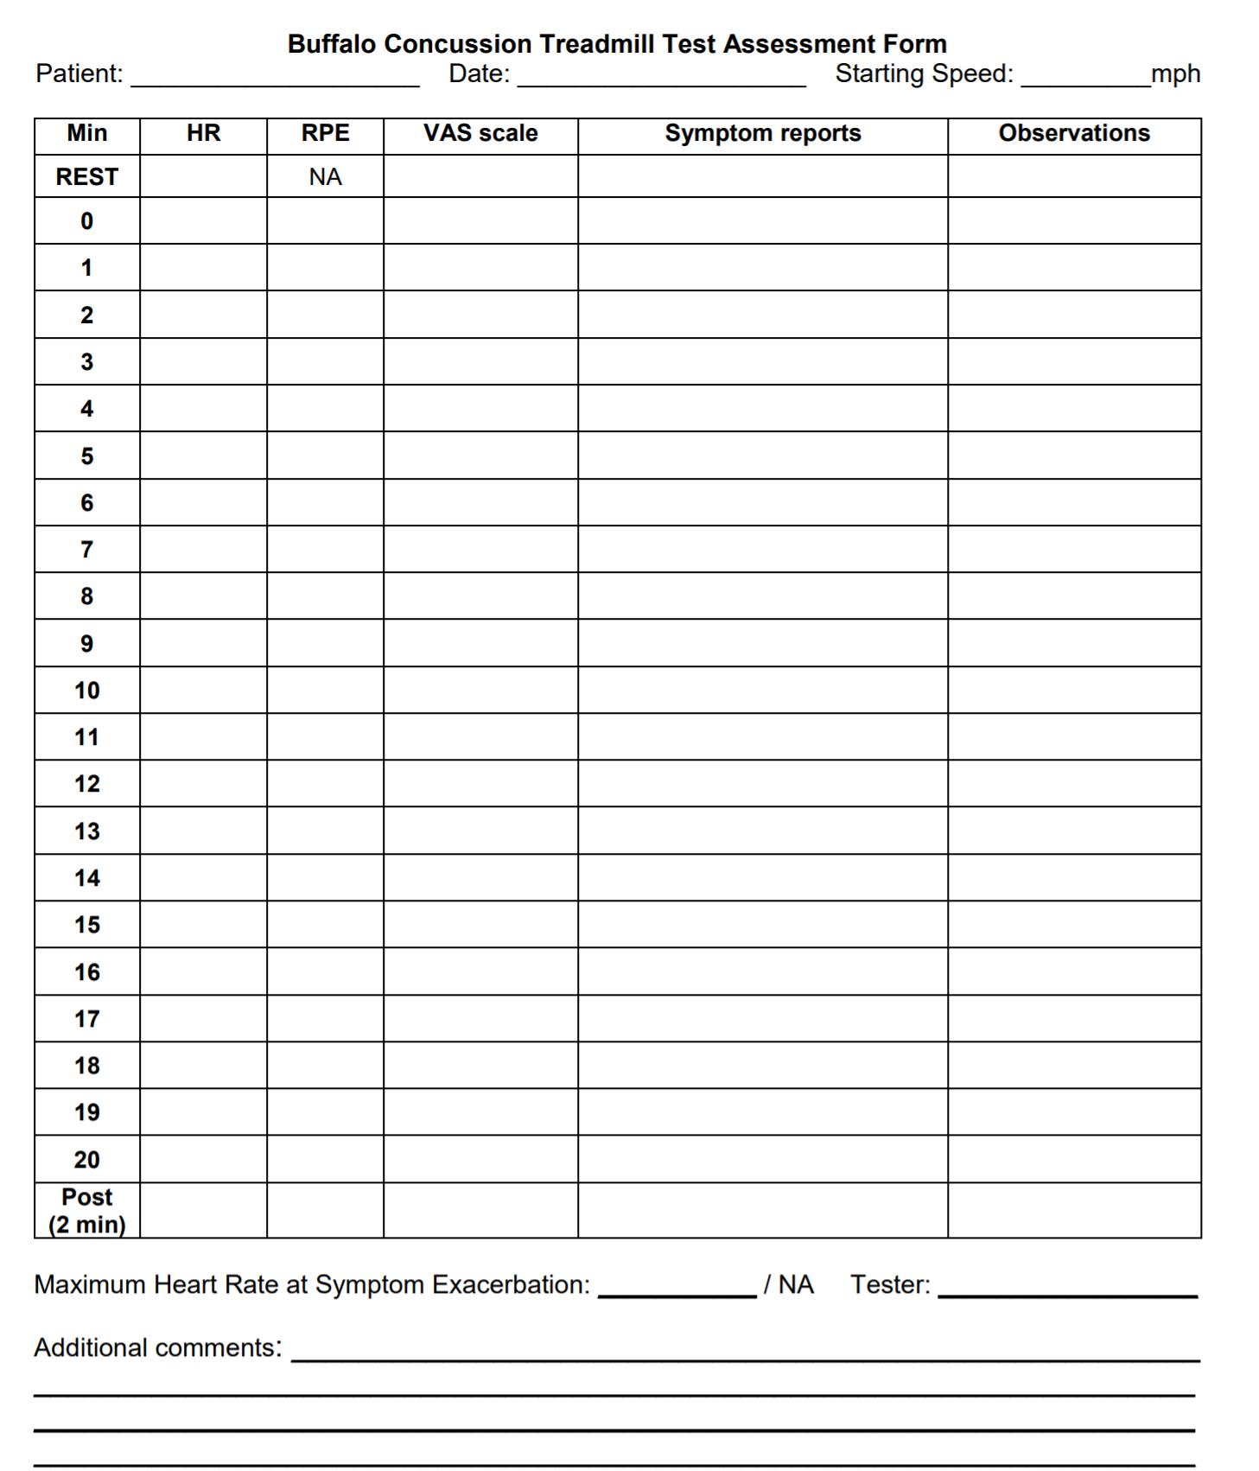
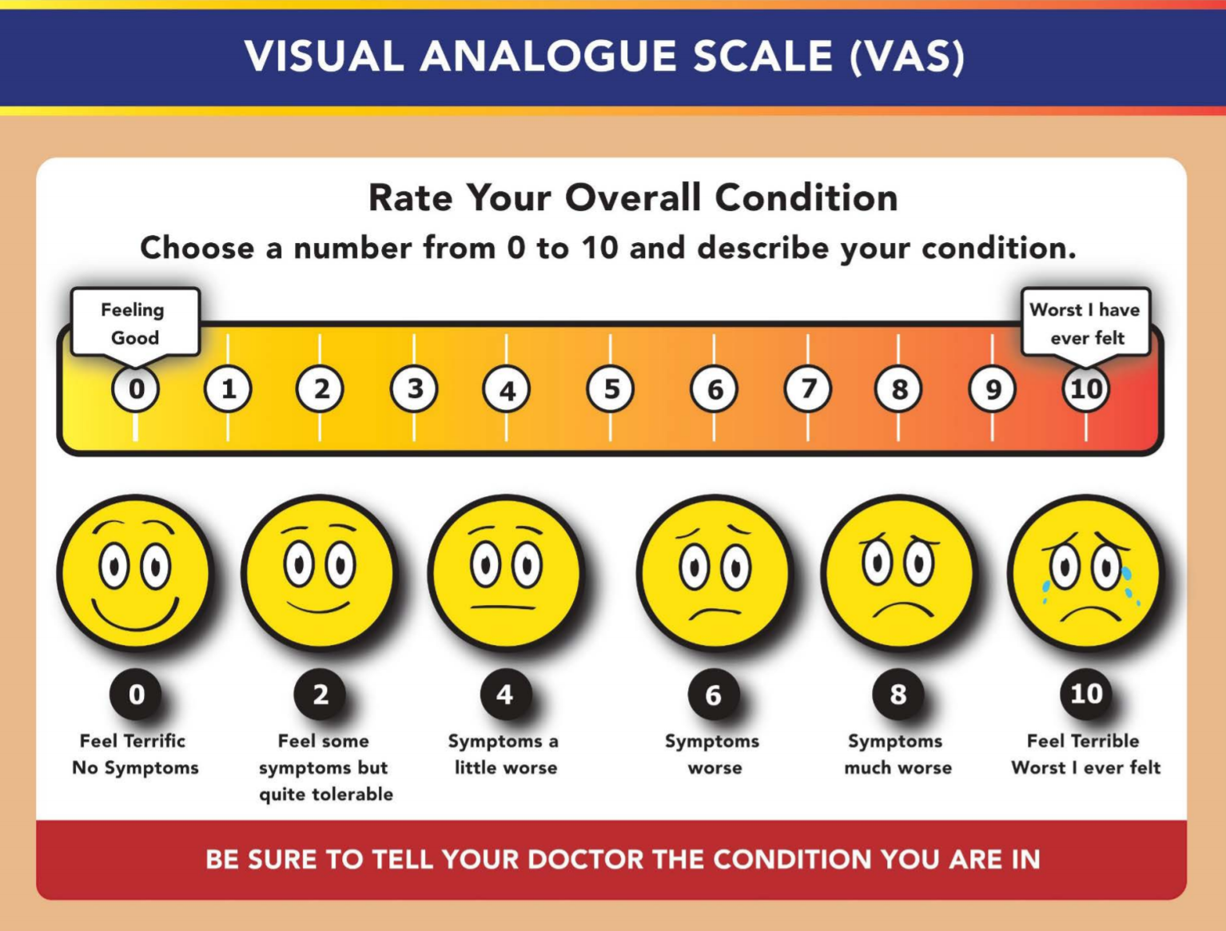
Background
Paper version of the test
Uses Visual Analog Scale (VAS)

Slide 5
Related Work
While there has not been substantial literature pertaining to the digitization of the BCTT, there has been work in proving the efficacy and validity of the BCTT, particularly literature detailing the relationship between BCTT performance over time and concussion recovery [1].
Using Google Scholar, we searched for the following pairs of boolean search terms: “Buffalo concussion treadmill test” AND “digital”; “Buffalo concussion treadmill test”
AND “FHIR” (acronym for fast healthcare interoperability resources, a standard in the electronic medical record field). There were no relevant search results that included these terms of interest, indicating that there is little or no work pertaining to implementing the Buffalo concussion treadmill test in a digital format.

Slide 6
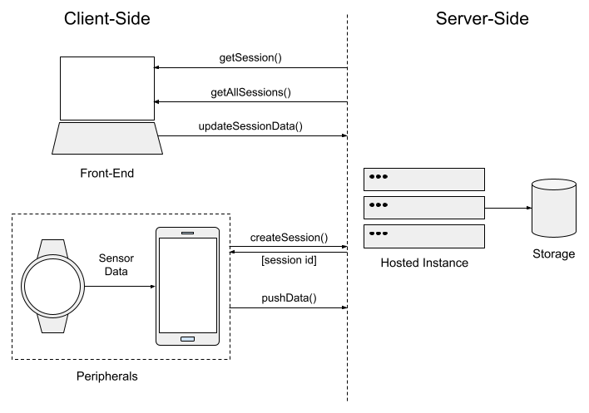
End-Point Interaction

Slide 7
Technical Details: IOS
Demo in Xcode

Slide 8
Future Work
Web app:
With the communication design between all three end-points established, the next task for the web portion of the project is to implement these contracts along with storage logic on the back-end to enable the full application end-to-end.
iOS app:
Send data to web application
Beautify the software and make sure it has a functionable and efficient flow. Time dependent, we may add different prompting or timing features on the phone to further improve the user experience.

Slide 9
Thank you!
Questions?

